Slide 1
基础valid IP Address 类型题目
468. Validate IP Address

Slide 2
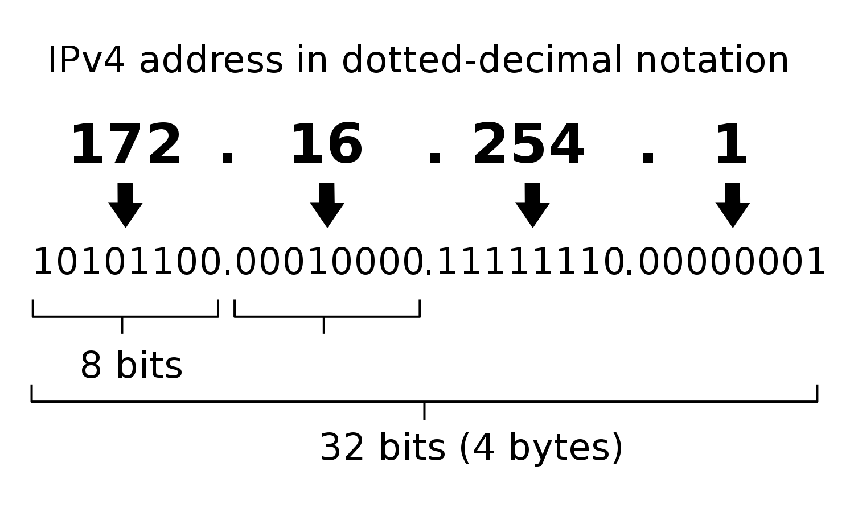
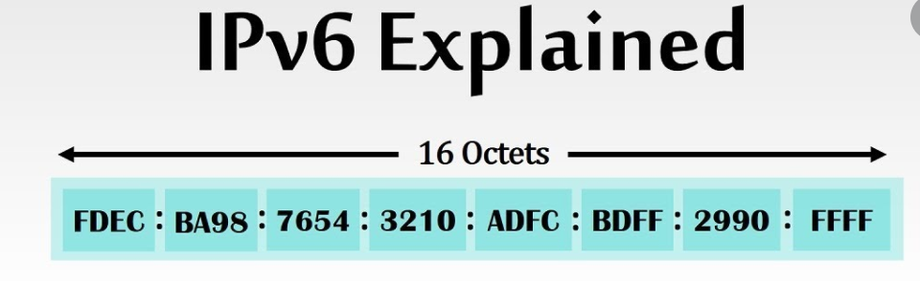
Ipv4 simplified version
3 dots
4 parts
Every part only digit 0~255
No leading zero (diff from real)
real life: Components of the dotted address can be specified in decimal, octal (with a leading 0), or hexadecimal, with a leading 0X))
IPV6
7 :
8 parts
Every part 1 <= len <= 4
Leading zero allowed
16 Octets Character or digit allowed

Slide 3
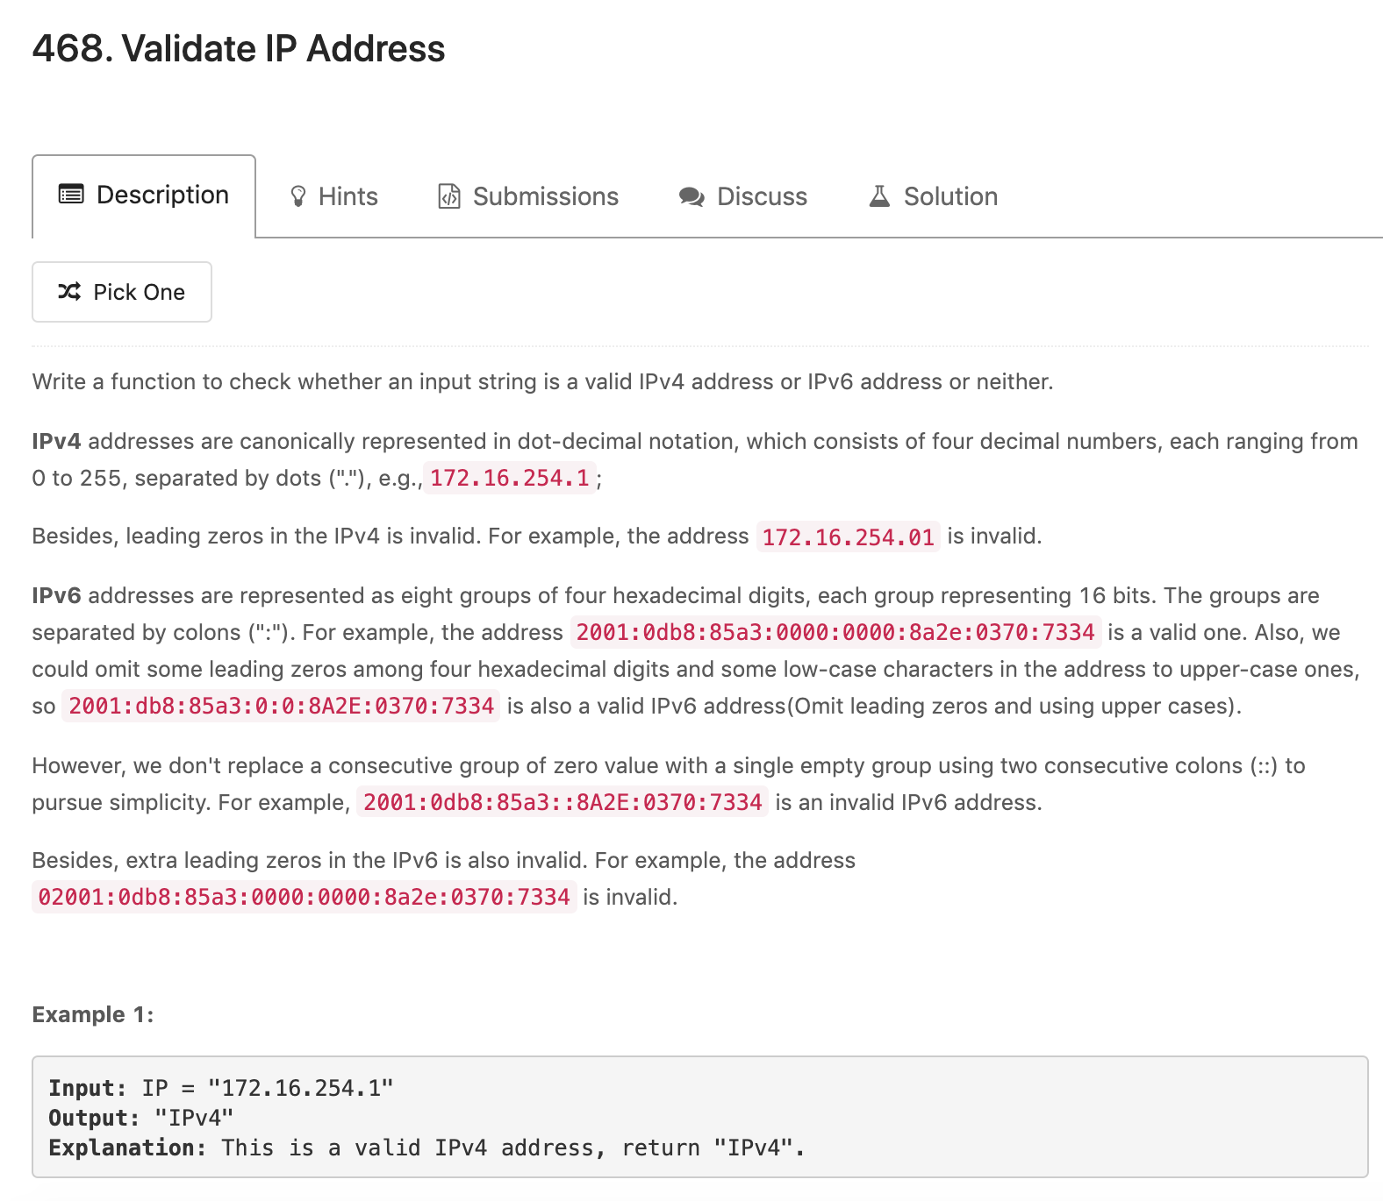
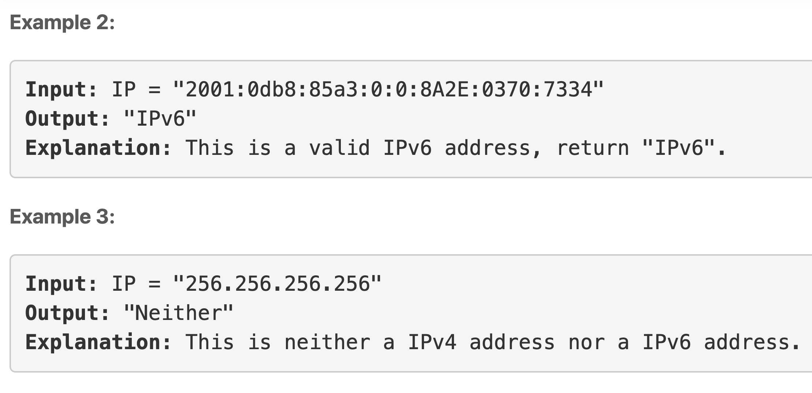

Slide 4
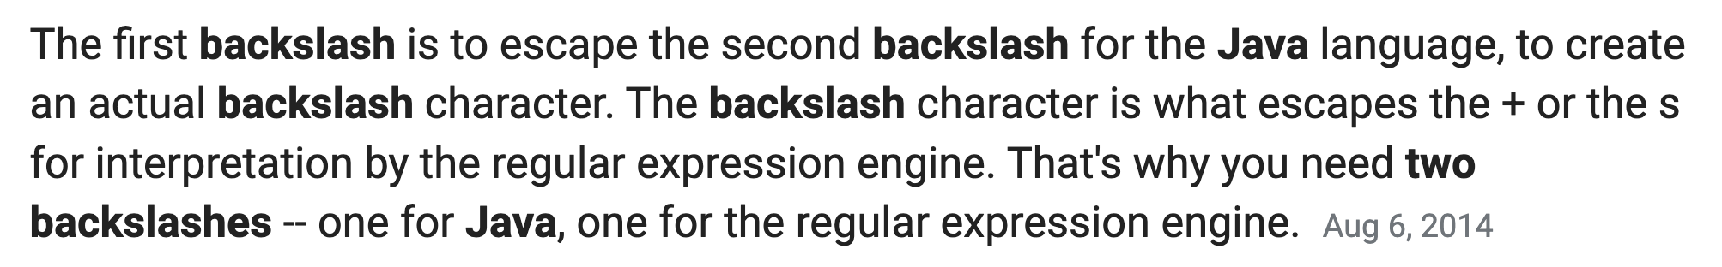
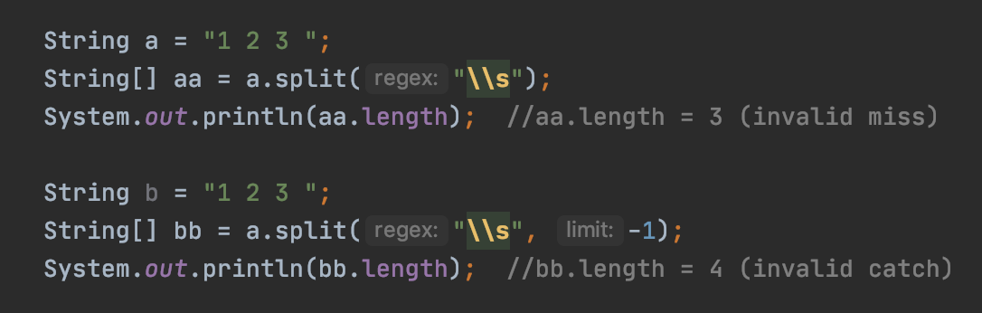
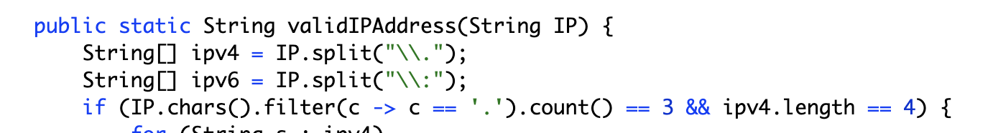
Using this way, you can detect empty ending into one part, and valid method will detect this “ “ empty part to be invalid ipv4/ipv6
Not recommend, can be replaced with following normal way

Slide 5
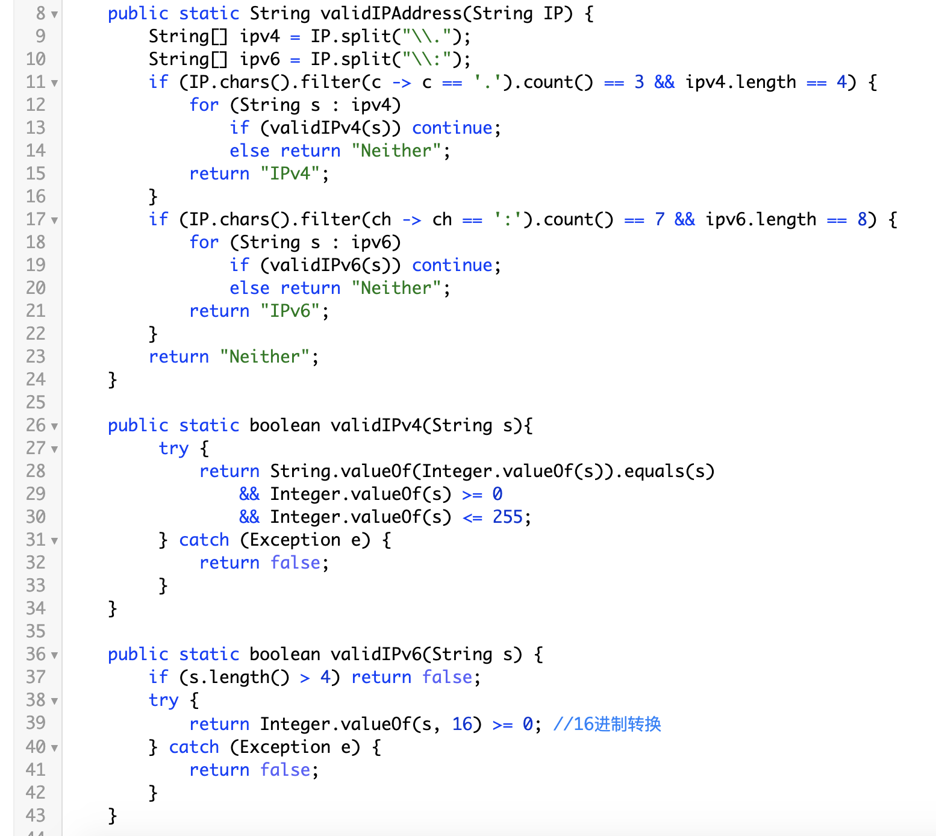
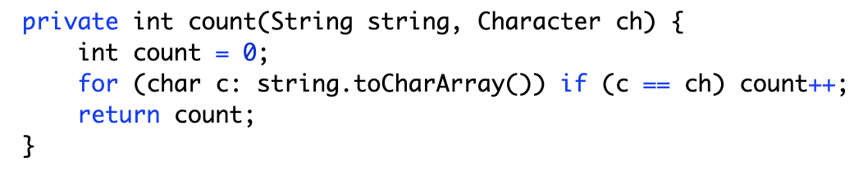
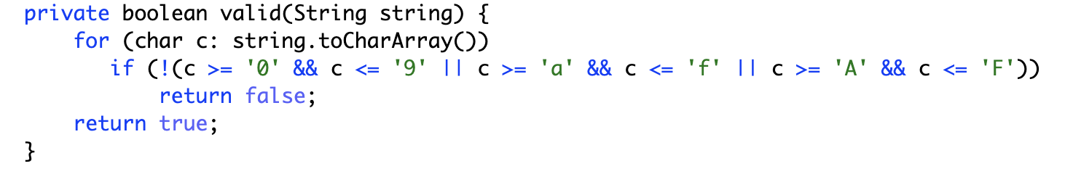
string.chars() -> convert to stream
stream().filter(a -> func(a)).count()
Filter the character only left ‘.’
if leading zero return false
Integer.valueOf(s, 16)
Convert string to 16 Octets

